Slide 1
Naan Mudhalvan – Generative AI project
Replicating MNIST dataset using GANs
Sree Vaasini S
2021503562
Batch 2

Slide 2
Dataset description
The dataset consists of grayscale images of handwritten digits, along with their corresponding labels.

Slide 3
Description of work implementation
Data Loading: loading the MNIST dataset using TensorFlow's built-in functionality
Data Preprocessing: The pixel values of the images are normalized to the range [-1, 1] to facilitate training. The images are also flattened into 1D arrays to be compatible with the input requirements of the neural networks.
Generator Architecture: multiple densely connected layers with ReLU activation functions and the hyperbolic tangent (tanh) as output layer
Discriminator Architecture consisting of densely connected layers with Leaky ReLU activation functions, output layer uses a sigmoid activation function to classify images as real or fake
e. Training Setup: The discriminator is compiled with the binary cross-entropy loss function and trained to distinguish between real and fake images and generator trained by combining it with the frozen discriminator
f. Training Loop: The GAN trained using a loop that iterates over a specified number of epochs. In each epoch, the discriminator and generator are trained alternately, with batches of real and fake images.
g. Visualization: The training progress monitored by plotting the discriminator and generator losses over epochs

Slide 4
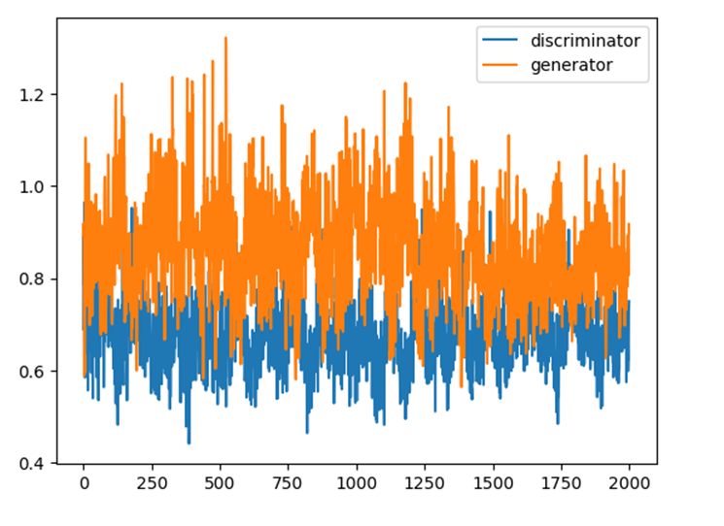
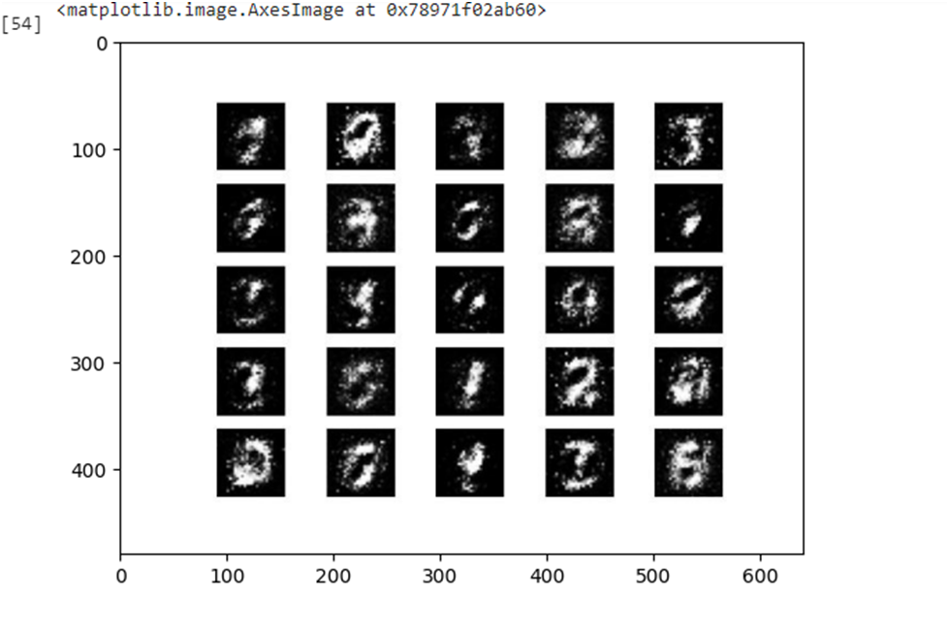
Output screenshots

Slide 5
Conclusion
By training on the MNIST dataset, the GAN learns to produce realistic images that closely resemble the dataset's original samples

